Slide 1
Networking inside of Kubernetes
Team: Alexander Trinh, Fuyao Wang, Zhe Deng,
Geng Song, Zhou Shen
Mentors: Anish Gupta, Bowen Song

Slide 2
Agenda
In this presentation we will cover:
The role of etcd (distributed database) in Kubernetes (container orchestration)
How and why etcd implements the RAFT protocol
How and why we are making a distributed database based on the Gossip protocol
Notes:
Etcd = “distributed etc”, etc used for config and metadata in Unix systems

Slide 3
Introduction
Problem: etcd’s RAFT protocol performs poorly on large cluster writes
What we plan to do:
Implement Gossip Protocol (CPISync, LevelDB, C++)
Preserve some major etcd design choices (e.g. key-value, logs, etc.)
Benchmark our distributed database against etcd
What we DON’T plan to do:
Replace RAFT
Store large amounts of data
Notes:
Background: Kubernetes uses Etcd (key-value storage written in Golang) for metadata and synchronization between master nodes. Etcd uses RAFT which does not perform well on writes for large clusters (>>1000 nodes) because of the single master/log replication architecture (discussed later)
Example of keeping design: keep WALs so that there is a chance of recovery from dead node?
Benchmark with emphasis on writes
Some data still needs strong consistency, therefore still use RAFT for it
Do not plan on storing > current Etcd limit of 8GB

Slide 4
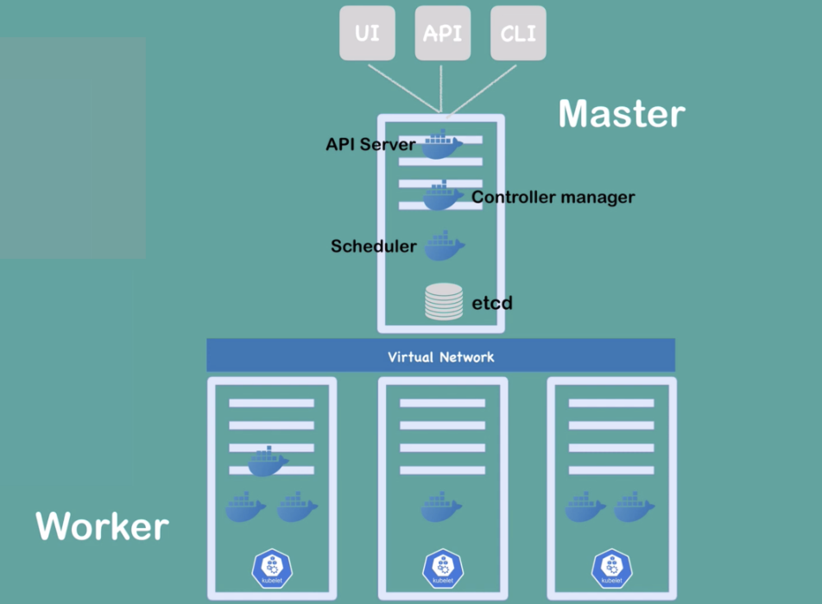
Kubernetes
Portable, extensible, open-source platform for managing containerized workloads and services
Worker Nodes execute programs
Master Node manages the cluster work properly
Virtual Network let them talk to each other

Slide 5

ETCD
Is a distributed key-value store
Kubernetes stores metadata about its nodes
PUT, GET, DEL
Node metadata
create_revision
mod_revision
version
lease
Notes:
Create revision is updated with a timestamp when a node is created
Mod revision is updated with a timestamp when a node is updated
Version allows for the cluster to revert back to older data
Lease is used for time sensitive data
A certain amount of time can be allocated to a node before its data is removed

Slide 6
ETCD
Multiple servers may run the same instance
Forms an etcd cluster
Highly available and strongly consistent
Able to read from any node
Writes are only processed at the master node
Uses RAFT protocol
Notes:
Multiple servers can run the same instance of etcd
This is what makes it highly available
The same data is consistent across all nodes and can be retrieved from any node
As a result, reads can occur at any node
However writes can only be processed at the master node
This update is then distributed to the other nodes using a reconciliation protocol called RAFT

Slide 7

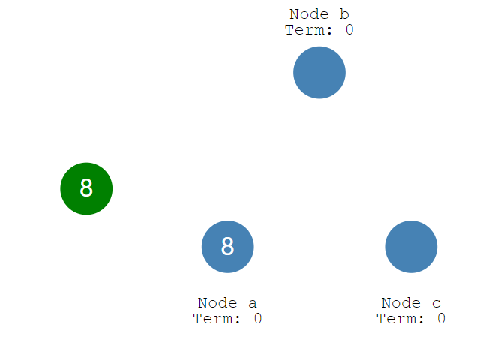
RAFT
Is a distributed consensus algorithm
Leader election

Slide 8
RAFT
Log replication
Pros and Cons of having a leader
Uses LevelDB with Gossip protocol

Slide 9
LevelDB
Key-value database
Supports Put, Get and Delete functions
NOT a distributed key-value store
Will be making LevelDB distributed using Gossip protocol
We will be comparing the efficiency of LevelDB running our protocol vs etcd and its RAFT protocol

Slide 10
Gossip
What is Gossip protocol?
Also called Epidemic Protocol
Only spread to unsent nodes
Never go back
Professor Trachtenberg’s repo:
https://github.com/trachten/cpisync
Notes:
It’s just like rumor spreading in social networks. One operation goes into one available node of the cluster, randomly. As soon as the node gets the data, it sends the data to some of its neighbours, then again and again. But they will only send data to unsent nodes and never go back.

Slide 11
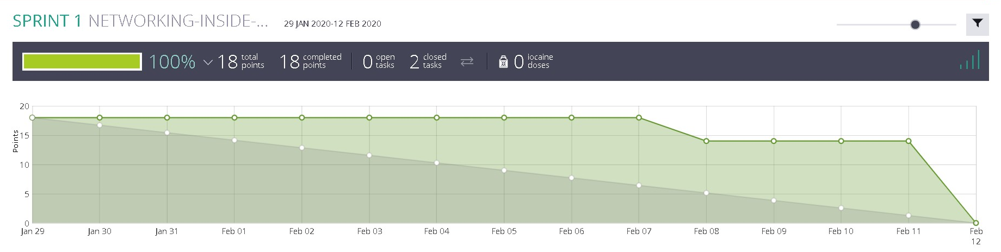
SPRINT 1
Conclusions:
Editing the source code of Etcd is not feasible goal for one semester
The project is less about Kubernetes and more about distributed databases

Slide 12
Next Steps
Next Sprint:
Start implementing Gossip Protocol in C++ with CPISync and LevelDB
Work on benchmarking etcd
Project Goals:
Finish a locally distributed database as described before
Incorporate our database into a container system (Stretch)
Notes:
Project goal #2 can be either with operators (eg etcd operator) or replacing a db protocol (eg etcd’s RAFT)

